Slide 1
Assignment 2: Due 9/8/16
Use the equality of discriminants to derive a quadratic equation for Bayes’
discriminant points in a 1D, 2-class problem with Gaussian class likelihoods
Mean and variance of C1 class likelihood are 3 and 1, respectively
Mean and variance of C2 class likelihood are 2 and 0.3, respectively
Assume priors are equal
With a sample size of 100, compare the MLE estimators to the true means
and variances.
For the same sample, compare Bayes’ discriminant points calculated from
MLE estimators with those derived from the true means and variances.

Slide 2
Assignment 3 due 9-20-16
Generate the in silico data set of 2sin(1.5x)+N(0,1) with 100 uniformly distributed random values of x between 0 and 5 with 100 normally distributed values of noise
Use 25 samples for training, 75 for validation
Fit polynomials of degree 1 – 5 to the training set.
Calculate at each degree.
Plot E_{in} (min sum squared residuals) and E_{val} vs degree of polynomial
Find the “elbow” in E_{val} for the best complexity for polynomial regression
Use the full data set to find the optimum polynomial of best complexity
Show this result as plot of data and fit on the same set of axes.
Report the minimum sum of squared residuals and coefficient of determination

Slide 3
Assignment 4, due 10-4-16
Suppose we want ε < 0.1 with 90% confidence (i.e. δ = 0.1)
VC bound says
If
then
Use a non-linear root-finding code to solve this implicit
relationship for N with d_{VC} = 3 and 6. Hint

Slide 4
Assignment 5: due 10-18-16
Apply linear regression to 1vs5 classification (text 81-88)
Attribute file (intensity, symmetry) with 424 examples is on class webpage.
1) Report in-sample error as mean sum squared residuals and number misclassified
2) Calculate 2x2 confusion matrix
3) Make a scatter plot like figure 3.2, text p83
4) Include discriminant, w^{T}x=bin average, in plot as boundary between classes
5) Calculate E_{CV-1} by leave-one-out
6) Compare E_{CV-1} with E_{in} as mean sum squared residuals and number misclassified

Slide 5
Expanded Assignment 6: Due 10-25-16
Start WEKA 3.8 and start the “Explorer window”
On the Preprocess tab, open the “logit-data.csv” file
Filter the data by clicking on “Choose” button -> filters -> unsupervised -> attribute -> NumericToNominal, then click “Apply” to generate a .arff
Go to the “Classify” tab and click the “Choose” button. Choose “SimpleLogistic” classifiers under “functions”.
Run with default settings and 10-fold cross-validation.
Include the results summary and confusion matrix in your report
Right-click in the result list to open visualization options. Include class-specific ROC curves in your report.
Return to the “Classify” tab and “Logistic” classifiers under “functions”.
Run with default settings and 10-fold cross-validation.
Include the results summary and confusion matrix in your report
The secret to the success of Simple Logistics may be its automatic attribute selection. In the output for Simple Logistics, find the attributes in be base case. Modify the excel file of logistic data to include only these attributes and rerun the Logistics case with default settings and 10-fold cross-validation. Include the results summary and confusion matrix in your report.

Slide 6
Assignment 7 due 11-3-16
Generate an in silico dataset with 55 examples of y(x) = 1 + 9x² + N(0,1)
with randomly selected values of x between -1 and +1.
With training set of 5 samples, fit a 4th degree polynomial to the data with and without regularization by choosing λ = 0, 0.0001, 0.001, 0.01, 0.1, 1, and 10. Plot E_{in} vs λ
Use the remaining 50 examples as a validation set. Plot E_{val} vs λ. Estimate the best value of λ from the plot.
Run your code 5 times. Does the best λ change dramatically from run to run?

Slide 7
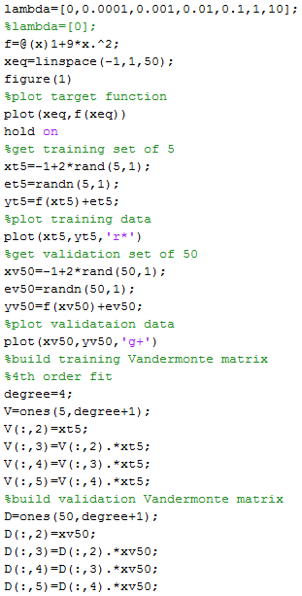
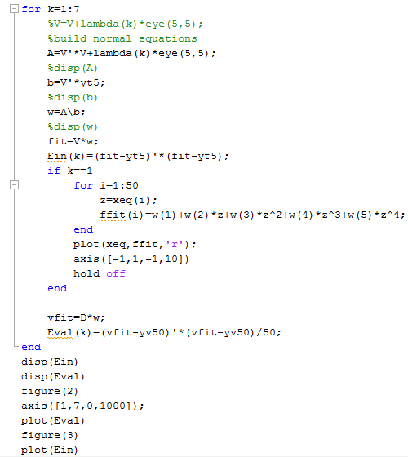
Codes for HW7

Slide 8
Assignment 8 due 11-1-16
Use the information-gain ranking filter on the leukemia gene
expression dataset from assignment #1 to find the top-5 genes.
Use IBk (K=5) with these 5 attributes to classify AML vs ALL.
Compare performance with results from HW1 where all genes
were used for classification.

Slide 9
Hints on use of Weka in HW8
As in HW1, open the leukemia gene expression file in Weka (see class website). This file has data from 72 leukemia patients (rows). The expression values are for 150 genes (columns). The last column is the type of leukemia (ALL or AML) for each patient.
Choose “Select Attributes” tab. Under “Attribute Evaluator” choose “InfoGainAttribeEval” and Search Method “Ranker” Start
Output shows genes ranked by information gain. Record which are the top-5 genes by this metric.
Choose “Preprocess” tab in Explorer. Mark the checkbox next to the top-5 genes. Go to the bottom of the gene list and mark “leukemia type”. Click on the “Invert” button above the gene list, which will change the marked checkboxes to the one you did not mark. Click on the “Remove” button at the below the gene list. Now you have a dataset of top-5 genes and their class label.
As in HW1 use IBk with K=5 to train as class predictor. Report performance as in HW1 and compare to that result.

Slide 10
Assignment 9 due 11-10-16
PCA of beer-bottle glass from breweries 1 and 6
Data set (on class website) contains 214 samples of bottle glass with 9 attributes.
1. Calculate covariance matrix
function named cov in MatLab
2. Find the eigenvalues and eigenvectors of the covariance matrix
function named eig in MatLab
3. Plot PoV
What percent of variance is captured by the 3 largest eigenvalues?
4. Make a scatter plot of (pc1, pc2)

Slide 11
Assignment 10 due 11-17-16
Use glassdataHW10.csv to develop a classifier for beer-bottle glass by Weka’s MLP, found under classifiers -> functions. Use default settings. Include Summary with confusion matrix in your report.
Compare your MLP results with multivariate linear regression followed by binning. Use 1 for AB, 2 for M, and 6 for PR. Report accuracy of classification and confusion matrix.

